Slide 1
Computer Organization and Architecture
Chapter 4
Notes:
Computer Organization & Architecture: Hardware and Software Organization. Actually they always go together.
And Programming Concepts!

Slide 2
Outline
Von Neumann Computer Architecture
Hierarchical Organization of the Computer System (Architecture)
The Operating System Components and Functions
Programming Language Concepts*
Notes:
Hierarchical Organization : Conceptual abstraction or Conceptual Model
Computer Organization: The components of a computer and their interconnection
What can you say about architecture of a building? Good architecture and bad architecture?
It is about good design. It is a design time decision.
It is about providing quality service to users of a system, not only about providing functions.
Architecture is strongly related to Quality.
Monolithic, Component or Module based, or Layered. Example of Component or Module based architecture is Expert System.
Monolithic : (Uniform or Solid), Shapeless, Poor Quality.

Slide 3
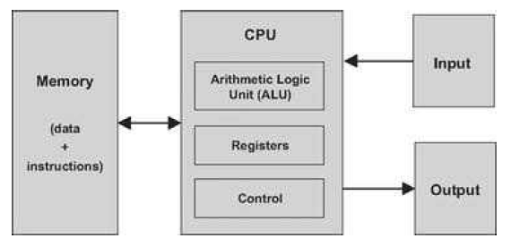
The von Neumann architecture (conceptual)
At this level of detail, this model describes the architecture of almost all digital computers. The program that operates the computer resides in its memory, in accordance with the “stored program” concept.
Notes:
Input, Output, Processor, Memory, and Data-path (Connectors, the arrowed lines)

Slide 4
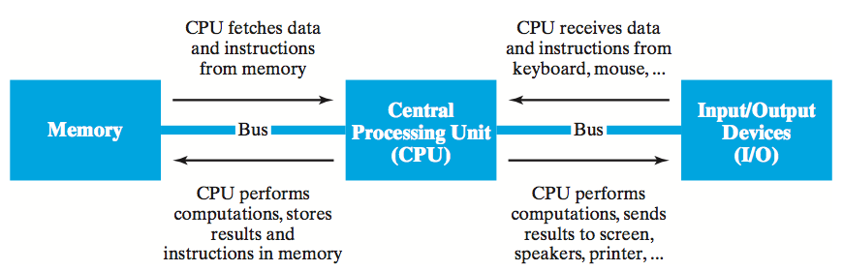
von Neumann Architecture
although specific components may vary, virtually all modern computers have the same underlying structure
known as the von Neumann architecture
named after computer pioneer, John von Neumann, who popularized the design in the early 1950's
the von Neumann architecture identifies 3 essential components
Input/Output Devices (I/O) allow the user to interact with the computer
Memory stores information to be processed as well as programs (instructions specifying the steps necessary to complete specific tasks)
Central Processing Unit (CPU) loads program instructions from memory and executes them in sequence.
Notes:
Von Neumann introduced and popularized the Stored Program concept :
The architecture is as shown and was first proposed by Von Neumann.
Store both data and programs in single (same) Memory together
Harvard Architecture = Stores data and instructions in separate memory.
What are control structures in programming (in C++)?
Central Processing Unit (CPU) loads program instructions from memory and executes them in sequence.
Interact with the user via Input / Output devices

Slide 5
Reading Assignment For more information about Von Neumann Architecture
Read The elements of computing systems, pages 100 – 105.
Read Concepts of programming languages, Sebesta, Section 1.4.1 (Computer architecture), pages 18 – 20.
Both books are uploaded on github/abedris.

Slide 6
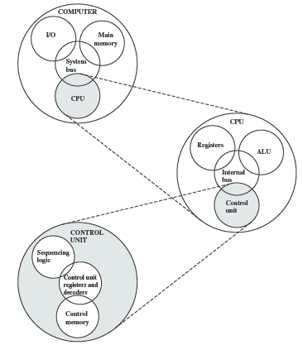
Figure from Computer Organization and Architecture, Stallings, 9th edition, page 13.
The Computer Top Level Structure
Notes:
This is essentially the Von Neumann architecture.

Slide 7
When you double click on an icon to run a program, here is what happens:
The program, which is stored inside the hard disk drive, is transferred to the RAM memory.
The CPU, using a circuit called memory controller, loads the program data from the RAM memory as directed by the OS.
The data, now inside the CPU, is processed. A program is a sequence of instructions to the CPU.
What happens next will depend on the program. The CPU could continue to load and execute the program or could do something with the processed data, like displaying something on the screen.
Notes:
At the end of a program, the CPU will return control to the OS.
The OS may send an interrupt signal to the CPU to execute high priority tasks or programs.
Just as a conceptual analogy, if not exactly same :
An engine runs in a cycle: intake, compression, ignition, and exhaust;
So does a computer's CPU: fetch, decode, execute, memory access and write
Machine languages are typically specified in two flavors: symbolic and binary. One way to cope with this complexity is to document machine instructions using an agreed-upon syntax, say LOAD R3,7 rather than 110000101000000110000000000000111. The elements of computing systems, page 128.
Everything is data to the CPU. Data and programs are both stored in memory as data!

Slide 8
The sequence of CPU steps can be expressed in pseudocode:
by the following algorithm
Initialize the program counter (IP or PC)
loop
fetch the instruction pointed by (the value in) IP
advance the instruction pointer (IP++)
decode the instruction (in IR)
execute the instruction
continue loop
Processor
Clock
Control Unit
Arithmetic Logic Unit
Registers
Notes:
All components of the CPU follow the speed of the clock (need to have comparable speed) as current technology allows.
Everything is done in fetch-Decode-Execute cycle. Fetch : go for and bring (something) for someone.
Go and Get the value pointed by IP, and load to IR
The Clock is used for Synchronization and/or Scheduling of activities to be Executed at the right time and Sequence (Scheduling, Timing and Sequencing)).
Synchronizing: make to occur at the same time (simultaneously) according to some rule (protocol) or strict Schedule.
Coordination ;
Decode : determine what to do (opcode is mapped to action); for example the opcode for mov is 1011 for intel 8088 CPU
The first field of every instruction is the opcode (short for operation code), which identifies the instruction,
telling whether it is an ADD or a BRANCH, or something else.
Many instructions have an additional field, which specifies the operand.
IP or Program counter (PC), Instruction Register (IR) is also another register
Execute can be: halt, jump, branch, loop, read, write, print, or break
The (real) work is done by the CPU and the underlying HW according to the (sequence) of instructions given by the OS.
The OS is a System Software composed of many supporting sub-system software components.

Slide 9
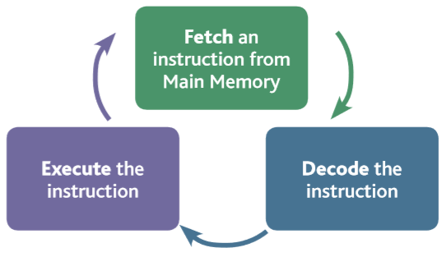
The CPU Fetch-Execute Cycle
The CPU consists of a control unit, registers, the arithmetic and logic unit, the instruction execution unit, and the interconnections (internal buses) among these components and the clock, of course .
Notes:
FETCH. The first step the CPU carries out is to fetch some data and instructions (program) from main memory then store them in its own internal temporary memory areas. These memory areas are called 'registers'. This is called the 'fetch' part of the cycle.
DECODE.
The next step is for the CPU to make sense of the instruction it has just fetched. This process is called 'decode'. The CPU is designed to understand a specific set of commands. These are called the 'instruction set' of the CPU. Each make of CPU has a different instruction set. The CPU decodes the instruction and prepares various areas within the chip in readiness of the next step.
EXECUTE.
This is the part of the cycle when data processing actually takes place. The instruction is carried out upon the data (executed). The result of this processing is stored in yet another register. Once the execute stage is complete, the CPU sets itself up to begin another cycle once more.

Slide 10
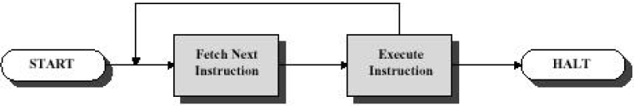
Processing required for a single instruction is
called an instruction cycle (Fetch-Execute Cycle),
and can be viewed as shown below: 2 Steps
Fetch Cycle Execute Cycle
Fetch – CPU(CU) reads an instruction from a location in memory and decodes the instruction (determine what it means)
Program counter (PC/Instruction Pointer) register keeps
track of which instruction executes next
Fetched instruction is loaded into the instruction register (IR)
Normally, CPU increments PC after each fetch
Notes:
Fetch – Decode – Execute is sometimes called Fetch – Execute
[Read might be more appropriate than fetch in this case, because in reading there is decoding] (my view)
Some literatures : Fetch → Decode → Dispatch → Execute
Dispatch : send off to a destination or for a purpose.
[I strongly believe, it is the instruction set that makes the decoding.]

Slide 11
Execute - CPU executes the instruction
§ May involve several operations
§ May utilize previously changed state of CPU
§ General categories:
CPU-Memory: Data may be transferred from CPU to memory or vice-versa
CPU-IO: Data may be transferred between CPU and an I/O module
Data Processing: CPU (ALU) may perform some arithmetic or logic operation on the data
Control: An instruction may specify that the sequence of execution be altered
Notes:
Control: halt, jump, branch, return

Slide 12
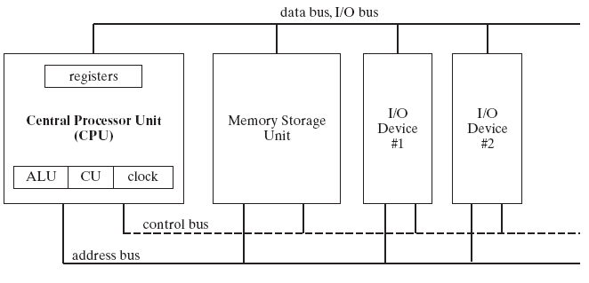
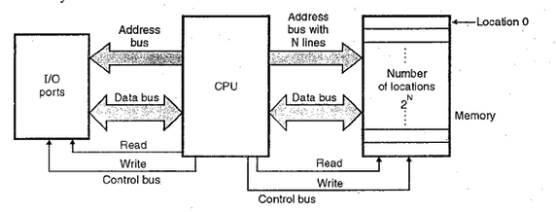
Block Diagram of a Microcomputer
Address bus width limits the amount of memory that can be installed in the computer
Notes:
Every new hardware installed should connect to the three busses and may need a device driver.
A kind of system software that interfaces the HW with the OS.
Address bus width: Limits the amount of memory that can be installed in a computer.
With N address bus lines, 2^{N} amount of memory can be installed.
Control bus: Read, Write, Reset
Applications of information technology have so far very much relied on the von Neumann paradigm of sequential computing. This paradigm is not appropriate for embedded systems, in particular those with real-time requirements, since there is no notion of time in von Neumann computing. Embedded Systems Design, page 16.

Slide 13
Programs Execution
The operating system reads the program into memory
adds it to a list of programs that want to execute
It gives it a time slice of the CPU
adds it to a list of programs that are executing
It saves the current state of the CPU when it gives another program a time slice of the CPU
Context switching
It restores the state of the CPU when a stopped program resumes execution.
Notes:
Context switching : an essential feature of a multitasking operating system.
Can you see any drawbacks here because of context switching?
Lost CPU time in switching between processes in a Queue.
Context-switch time should be small fraction of the time quantum (time slice of execution).
What happens when a user double clicks on an icon of a program?
Queuing;
The OS may interrupt a running program by sending an interrupt signal to the CPU when a high priority program wants CPU time.

Slide 14
CPU Speed
Processor speed depends on:
Internal Clock Speed
Type of Instruction Set
Processor Implementation
Compiler Design (efficient binary executable)
Cache and Memory Hierarchy
etc…
Reading Assignment: CISC & RISC
Notes:
Intel and AMD may implement the same instruction set differently.
In some processors 50% of the CPU is cache memory
CISC and RISC can be discussed here
Abstraction: the quality of dealing with ideas rather than events.
: something which exists only as an idea
synonyms: concept, idea, notion, thought, generality, generalization, theory, theorem, formula,
hypothesis, speculation, conjecture, supposition, presumption
Simple processors running interpreters. Thus a complex hardware design could be
turned into a complex software design, CISC.
RISC uses VLSI advantage most instruction set is implemented in hardware.
Processor Implementation : For example; Is pipelining used? Or whether other techniques are used.
VLIW : Very Long Instruction Word

Slide 15
The hierarchy of levels
Digital logic: The implementation of computation by digital devices.
Microarchitecture: The structure of a computer processor.
Instruction set architecture: The operations provided by a computer processor.
Operating system: The extension of the instruction set by additional services.
Assembly language: The representation of executable program by textual descriptions.
Notes:
The hierarchy of levels of computer system organization.

Slide 16
Notes:
Hardware and software are logically equivalent.
Hardware is just petrified (fossilized, solidified) software.
Layer 3, System Software (OS Library Code) : Linking, Loading, and running.
CISC and RISC can be discussed here or at next slide
Abstraction: the quality of dealing with ideas rather than events.
: something which exists as an idea [ and can be realized later on]
➔ Abstraction is used to simplify design at different levels of representation;
→ lower-level details are hidden to offer a simpler model at higher levels.
Microarchitecture
• detailed organization of a processor implementation
• different implementations of a single ISA
Discuss about translation and interpretation. Always a machine interprets to the level below.
Compiling and Assembling are translations.

Slide 17
The Computer as a multilevel machine
A six-level computer. The support method for each level is indicated below it (along with the name of the supporting program)
Notes:
Structured computer organization, 6th edition, page 5.
ISA is a kind of Software instruction to Hardware execution component mapper (my definition)!
Contemporary multilevel machine
Microcomputer architecture or Microarchitecture level => consists of Registers, ALU, and other CPU components
Hardware and software are logically equivalent.
Hardware is just petrified (fossilized, solidified) software.
The interpreter is written in low-level instructions called microcode (or firmware), which is stored in read-only memory and executed by the hardware.
CISC and RISC can be discussed here or at next slide [CISC cost effective and slow, RISC expensive and fast]
Abstraction: the quality of dealing with ideas rather than events.
: something which exists as an idea [ and can be realized later on]
➔ Abstraction is used to simplify design at different levels of representation
→ lower-level details are hidden to offer a simpler model at higher levels.
Simple processors running interpreters. Thus a complex hardware design could be
turned into a complex software design. CISC
RISC uses VLSI advantage most instruction set is implemented in hardware.
microprogram or hardware execution circuits
Microprogram is software, hardware execution circuits are hardwired
Examples are : CISC and RISC can be discussed here

Slide 18
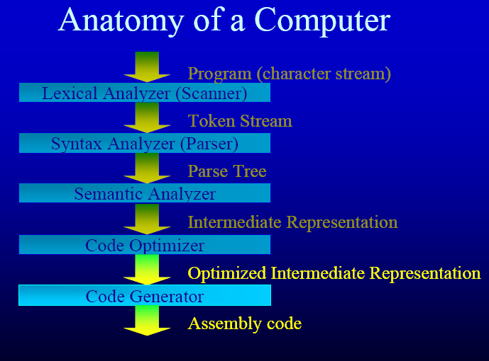
Compiler
Notes:
Anatomy : study of the structure of something
Lexicon = Vocabulary
Syntax = grammatical structure
Lexical Analyzer : Checks if character stream or source code content in in the vocabulary of the programming language.
Syntax Analyzer : Checks the Grammatical correctness of the source code (token stream) …
Semantic Analyzer : Determines the intent (meaning) of the program without ambiguity.
Compilation and Interpretation difference can be explained here.
During execution, a compiled program is in control of the computer (or machine below).
While in interpretation, the interpreter controls the computer (or machine).
Smallest Individual Element of a Program is called a token.
A token is the smallest meaningful unit in a computer program.

Slide 19
Operating Systems
An operating system (OS) is a set of programs containing instructions that work together to coordinate all the activities among computer hardware resources
Start and shut down a computer
Provide a user interface
Manage programs
Manage memory
Coordinate tasks
Configure devices
Establish an Internet connection
Monitor performance
Provide utilities
Automatic update
Control a network
Administer security
Notes:
The process of starting or restarting a computer is called booting :
Cold boot : Turning on a computer that has been powered off completely
Warm boot : Using the operating system to restart a computer
Utility programs : File manager => Copying, renaming, deleting, moving, and sorting files and folders
=> Displaying a list of files, Organizing files in folders
: Search utility, Image viewer, Uninstaller, Defragmenter, Backup & Restore Utility, Firewall, Antivirus, File Compression, Media Player, CD Burner
A disk cleanup utility searches for and removes unnecessary files : Downloaded program files,
Temporary Internet files, Deleted files, Unused program files

Slide 20
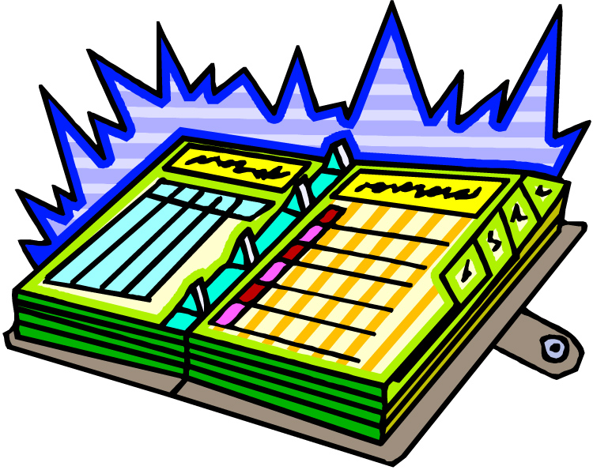
Operating System - Organizer
Keep track of executing programs
Give them time with the CPU
A program gets a slice of time with the CPU
Keep track of memory
Decide when to move some data to disk (virtual memory)
Keep track of disk space
Decide where to store stuff
Interface with the user
Accept input via keyboard and mouse
Keep track of devices
USB drives, cameras, etc
Provides networking capabilities
Notes:
An operating system is best described as a System Management Program.
Can you give me an example of server operating systems?
What makes the server operating system different?
Can serve thousands of users or computers at the same time. Should be installed on a special hardware to work to full capacity.

Slide 21
The Operating System and the Kernel
kernel: The operating system kernel is the part of the
operating system that responds to system calls,
interrupts and exceptions.
Ex. system(“cls”); from C++ source, in <stdlib.h>
operating system: The operating system as a whole
includes the kernel, and may include other
related programs that provide services for
applications.
This may include things like:
– utility programs
– command interpreters
– programming libraries
– device drivers, etc.
Notes:
System calls are Interfaces between the kernel and other components of the computer system.
The Linux Kernel and Windows 10 : It is said that latest version of Windows 10 is Developed using Linux Kernel!
Utility programs : File manager => Copying, renaming, deleting, moving, and sorting files and folders
=> Displaying a list of files, Organizing files in folders
: Search utility, Image viewer, Uninstaller, Defragmenter, Backup & Restore Utility, Firewall, Antivirus, File Compression, Media Player, CD Burner
A disk cleanup utility searches for and removes unnecessary files : Downloaded program files, Temporary Internet files, Deleted files, Unused program files

Slide 22
Programs can be executed in different ways.
Source
Program
Interpreter
Bytecode
Compiler
Compiler
Bytecode
Bytecode
Interpreter
Machine
Language
Notes:
Programming languages are the bridge between programmers and machines. It is in them that algorithms must be represented for execution.
What does the red arrows represent in this diagram?
Input and Output (IPO)
Compilation and Interpretation difference can be explained here.
During execution, a compiled program is in control of the computer (or machine below).
While in interpretation, the interpreter controls the computer (or machine).

Slide 23
Classification of programming languages
Imperative
Procedural: C, Ada, Pascal, Algol, FORTRAN, . . .
Object oriented: Scala, C#, Java, Smalltalk, SIMULA, . . .
Scripting: Perl, Python, PHP, javascript, . . .
Declarative
Functional: Haskell, SML, Lisp, Scheme, . . .
Logic: Prolog
Dataflow: Id, Val
Constraint-based: spreadsheets, SQL
Template-based: XSLT
Notes:
Java is an OOP programming language while JavaScript is an OOP scripting language.
Java creates applications that run in a virtual machine or browser while JavaScript code is run on a browser only.
Procedural (3rd generation), object Oriented (4th generation), and Scripting (5th generation)
XSLT : eXtensible Stylesheet Language Transformations
In prolog, logic is expressed as relations (called as Facts and Rules).
Prolog is a logic programming language. It has important role in artificial intelligence.
SML : Standard ML , Lisp : LISt Processor (uses linked lists as its data structures)
Java code needs to be compiled while JavaScript code are all in text.

Slide 24
Why are there so many languages?
Evolution.
Special purposes.
Personal preference.
Notes:
Why are there so many programming languages?
Some programming languages are much easier to learn than others (learning curve)
Some languages are much better suited to certain tasks than others
There is no best programming language in all aspects
A hypothesis that explains why applications use several different programming languages is that the “problem space” of the application is broader than the “solution space” of individual programming languages.
XSLT (eXtensible Stylesheet Language Transformations) is a language for transforming XML documents into other XML documents, or other formats such as HTML for web pages, plain text or XSL Formatting Objects, which may subsequently be converted to other formats, such as PDF, PostScript and PNG

Slide 25
Assignment:
Carry out investigations about types and functions of operating systems, and CPU scheduling algorithms. Include server operating systems in your enquiry. Give more emphasis to CPU scheduling algorithms.
Work in groups of two students and submit your findings in printed copies.

